Slide 1
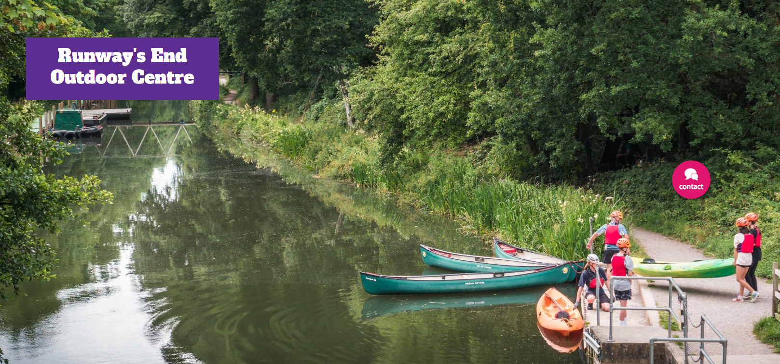
Year 6 Residential 2023

Slide 2
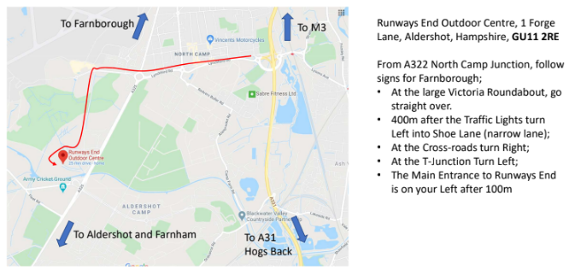
Wednesday 12th – Thursday 13th July 2023
At Runways End Education Centre

Slide 3
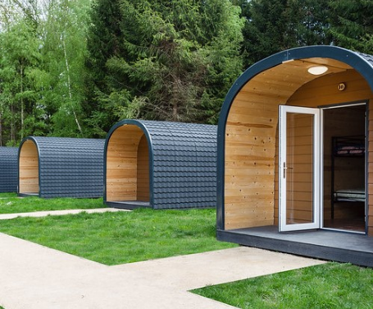
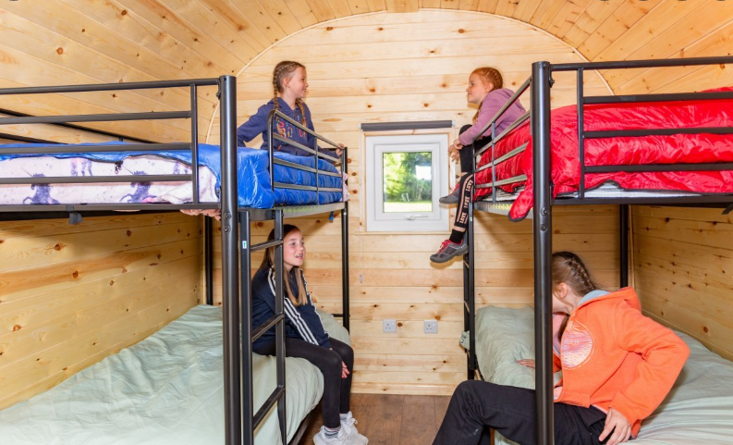
Accommodation – Camping Pods
Each pod sleeps 4 in 2 sets of bunk beds.
We have asked the children who they would like to share with and will do our best to accommodate their wishes.
They are located a short walk from the shared toilet and shower blocks.
Each pod is lockable and keys will be kept in a key safe, accessed via a code.
The teachers will have a master key in case of emergency.

Slide 4
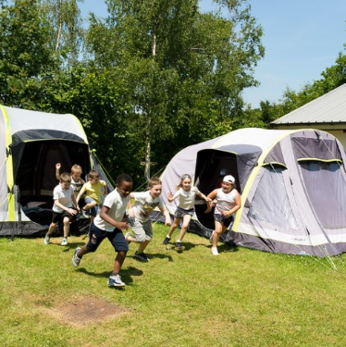
Accommodation – Camping sites
Majority of children will be sleeping in their own tents or those provided for them.
PLEA for tents
They will be sharing with at least 1 other child but may have as many as 7 other children in their tent.
We have asked the children who they would like to share with and will do our best to accommodate their wishes.

Slide 5
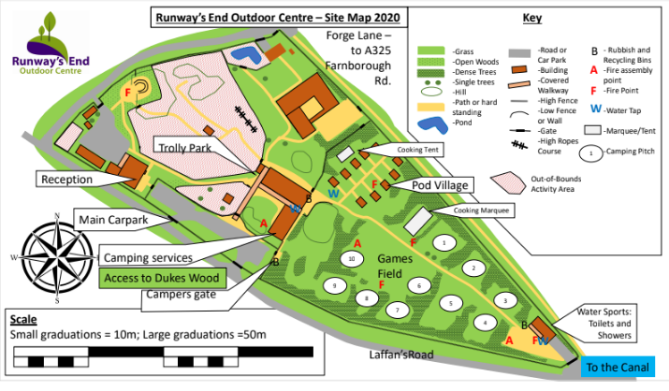
Site Map

Slide 6
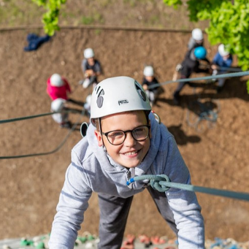
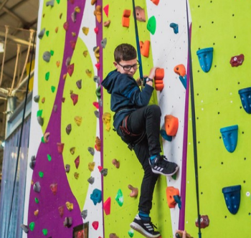
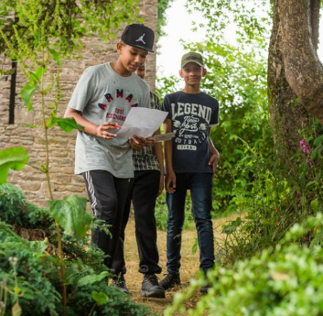
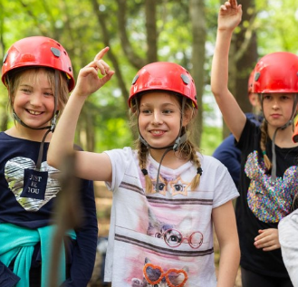
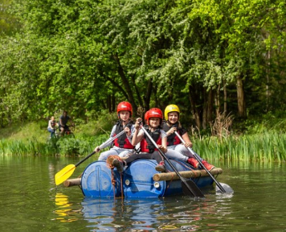
Activities
In groups of 11 or 12 each with a member of Talavera staff
They will participate in a round-robin of activities including:
- raft building or canoeing or kayaking
- climbing and abseiling
- water rocket/team building tasks
- archery and caving
- a camp fire

Slide 7
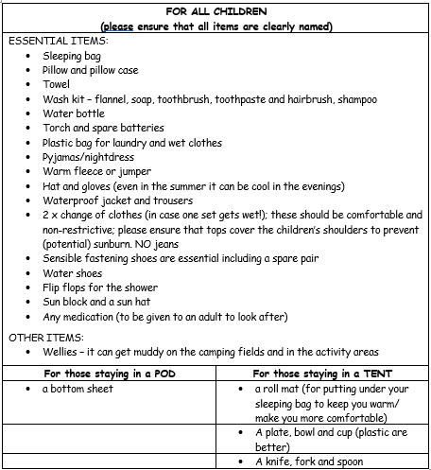
Equipment list
PLEASE NAME EVERYTHING – children are responsible for looking after their own belongings
Children should ensure they have old clothes and trainers (ones that you/they don’t mind getting wet) for the water-based activities
Clothes should cover their shoulders/legs to prevent potential sunburn (no jeans)
They are not allowed to wear crocs or flip flops during the other activities.
You must pack SUN CREAM that the children can apply themselves and a named WATER BOTTLE
NOT ALLOWED: mobile phones or tablets
AT YOUR OWN RISK: any valuables

Slide 8
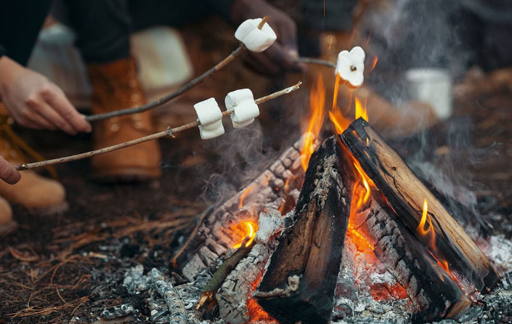
Catering
We will be self-catering
Children will need to bring their lunch for Wednesday and a named water bottle for use throughout the two days.
We will be providing/cooking an evening meal on Wednesday evening, breakfast on Thursday morning (toast, cereal etc) and a packed lunch on Thursday.
We will be having a camp fire on Wednesday evening with hot chocolate and marshmallows!

Slide 9
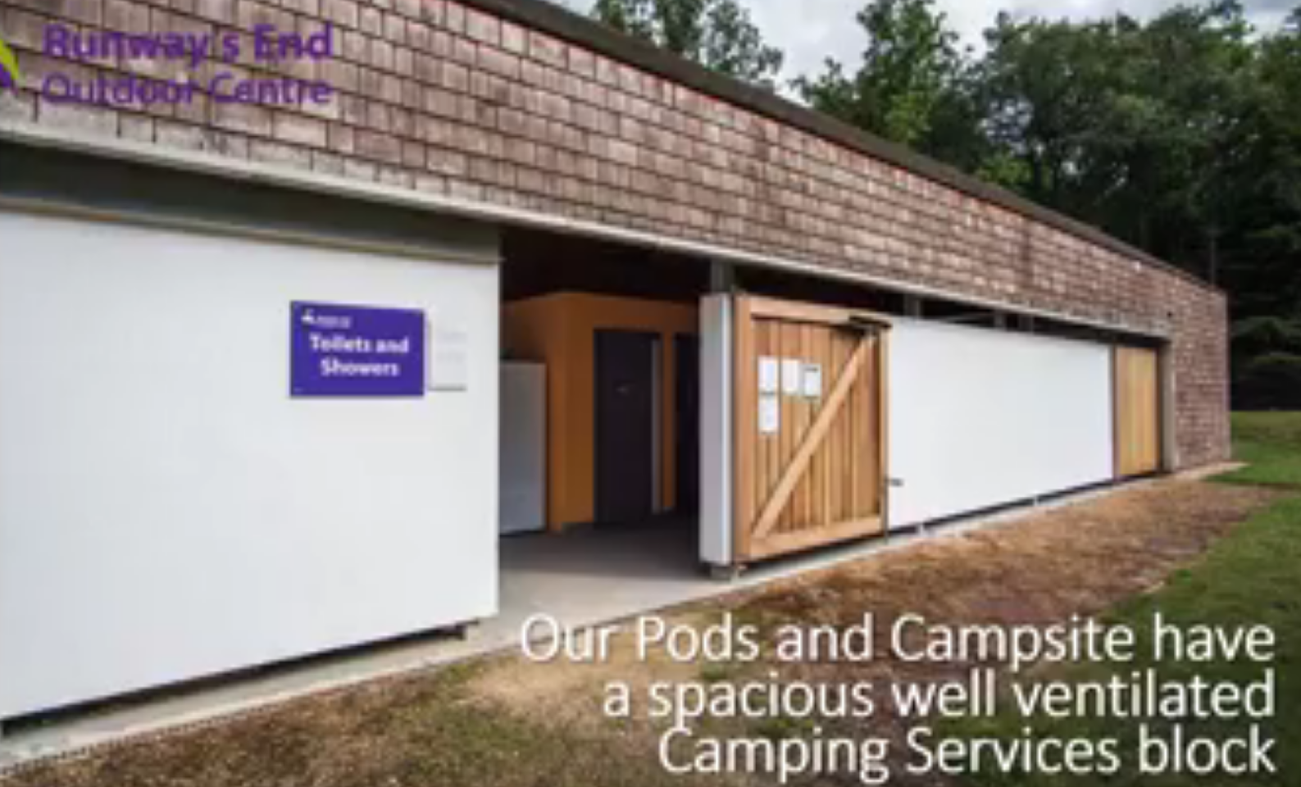
Amenities

Slide 10
Extra information
Wednesday: Drop-off at Runways End NO EARLIER THAN 9:00 am. Before this time we will not be available to supervise and or permitted to allow the children on site. We will take the register at 9:30 am.
Thursday: Collection from Runways End between 2:15 and 2:45 pm.
Please car share if possible due to limited parking available.

Slide 11
What’s next?
Let us know if you can lend us a tent and if so how many it sleeps!
Let us know if you can stay and help set up the tents on Wednesday morning and help to take them down on Thursday afternoon.
Let us know if there is anything we can do to help

Slide 12
Any questions?

